Slide 1


The Innovation Literacy Programme

Slide 2
Why The Innovation Literacy Programme
Business leaders are ‘Time & Capacity Poor’ for innovation adoption
Productivity In Greater Manchester is below the national average (GVA/hr worked)
Greater Manchester’s has over 10,000 apprentices across various industries.
Apprentices are in ‘learning mode’ They bring fresh eyes and ideas to businesses.
Vision: Apprentices as Innovation Ambassadors.
Solution: Innovation Literacy Programme

Slide 3
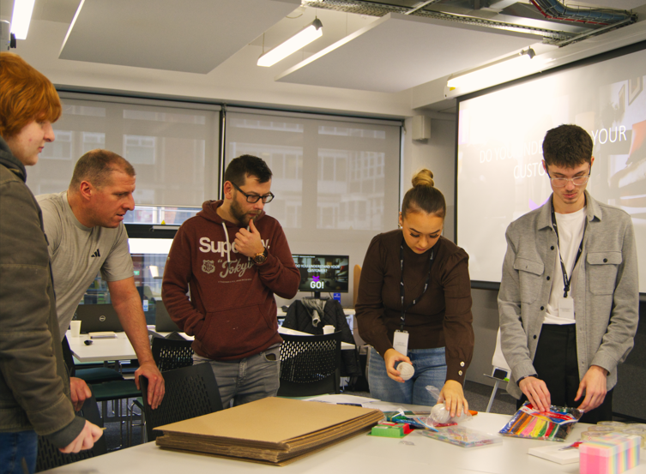
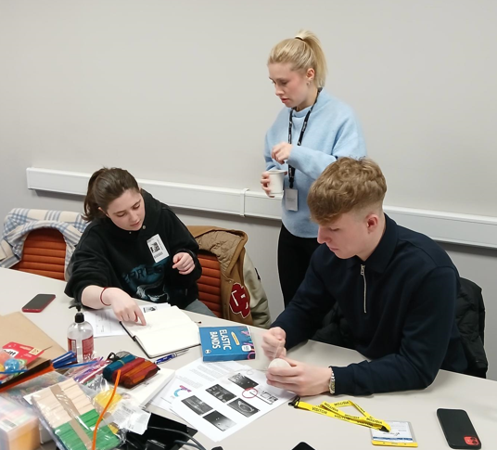
What is it?
A unique training opportunity available to apprentices, free of charge that aims to equip them with the skills to:
Support innovation, efficiency and productivity in any business/organisation
Communicate their ideas in a professional manner
Make an Impact on your business with fresh perspectives and ideas
Build soft-skills and confidence
Enable professional development linked to the most desirable skills for the modern workforce, as identified by the Innovation Commercialisation and Entrepreneurs hip Skills Framework.

Slide 4


What Will Apprentices Learn?
Module 1 - Foundations of Innovation
A deep dive into the concept of innovation, its historical and modern-day impact, and how it applies to the real world with activities including researching innovation in their sector. We then move on to generating ideas focusing on frustration in their own roles. We discuss brainstorming techniques, idea generation, and fostering curiosity to find and develop innovative ideas.
Module 2 – Prototyping and Problem Solving
This module emphasises the tangible aspects of innovation and creativity, including how physical models can quickly help deepen understanding of product or service innovations. We finish this module by exploring an expansive range of testing and evaluation methods to check the product solves the original problem and meets the business need.

Slide 5
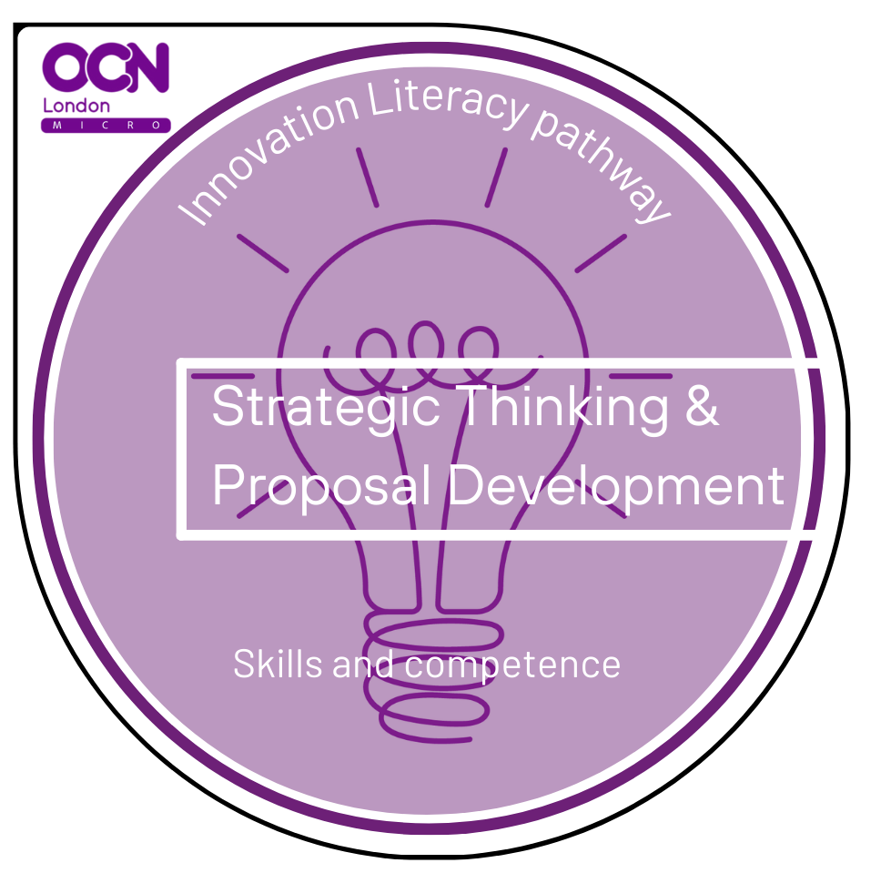

What Will Apprentices Learn?
Module 3– Strategic Thinking & Proposal Development
Discusses gathering relevant data, understanding the environment, and using metrics to support innovation proposals (e.g. PESTLE analysis etc.) and uses this knowledge to create impactful proposals for innovation ideas a structured format like a Vision Specification document.
Module 4– Communication & Culture of Innovation
Emphasises the tangible aspects of innovation and creativity, including how physical models can quickly help deepen understanding of product or service innovations and goes on to explore how to foster a culture of innovation within your organisation with some ideas for personal growth.

Slide 6

Who Is Eligible To Attend?
The Employer:
Can be any sector but priority is to private/SME businesses with under 250 staff
The Apprentice:
Can be on any apprenticeship pathway and any level (may be most suitable for levels 3, 4 & 5)
“….the skills and confidence Melissa has come back with, the confidence to test things and take control of some elements has freed up some of my time.”– Marketing Manager,

Slide 7
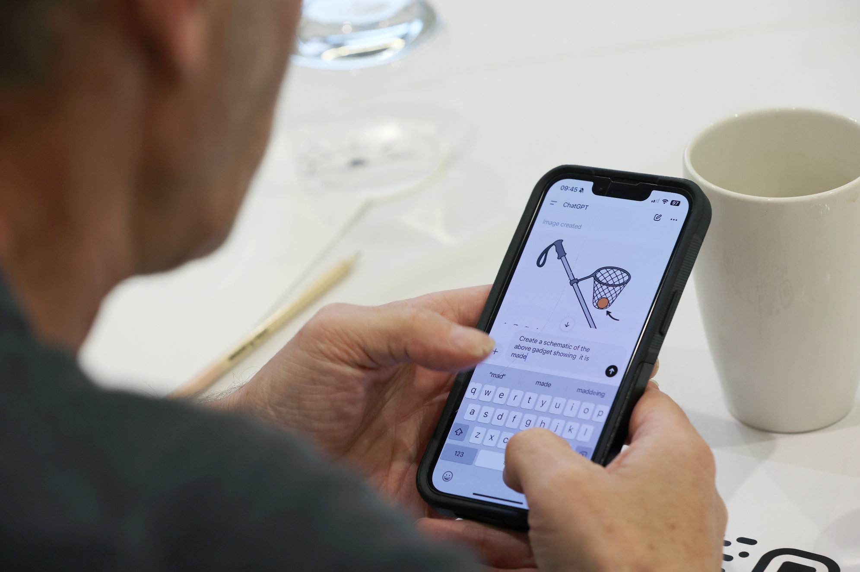
The Benefit to Employers
Support your organisations bottom line
Increase productivity
Realise apprentice creativity
Help them embrace failure
Hands-on experience of developing ideas
Learn How To Communicate concepts
CPD
“Since Joe has undertaken and completed the course, there has been a noticeable change in his confidence to communicate with his operational colleagues and more so, site managers.” – Operations Manager,

Slide 8
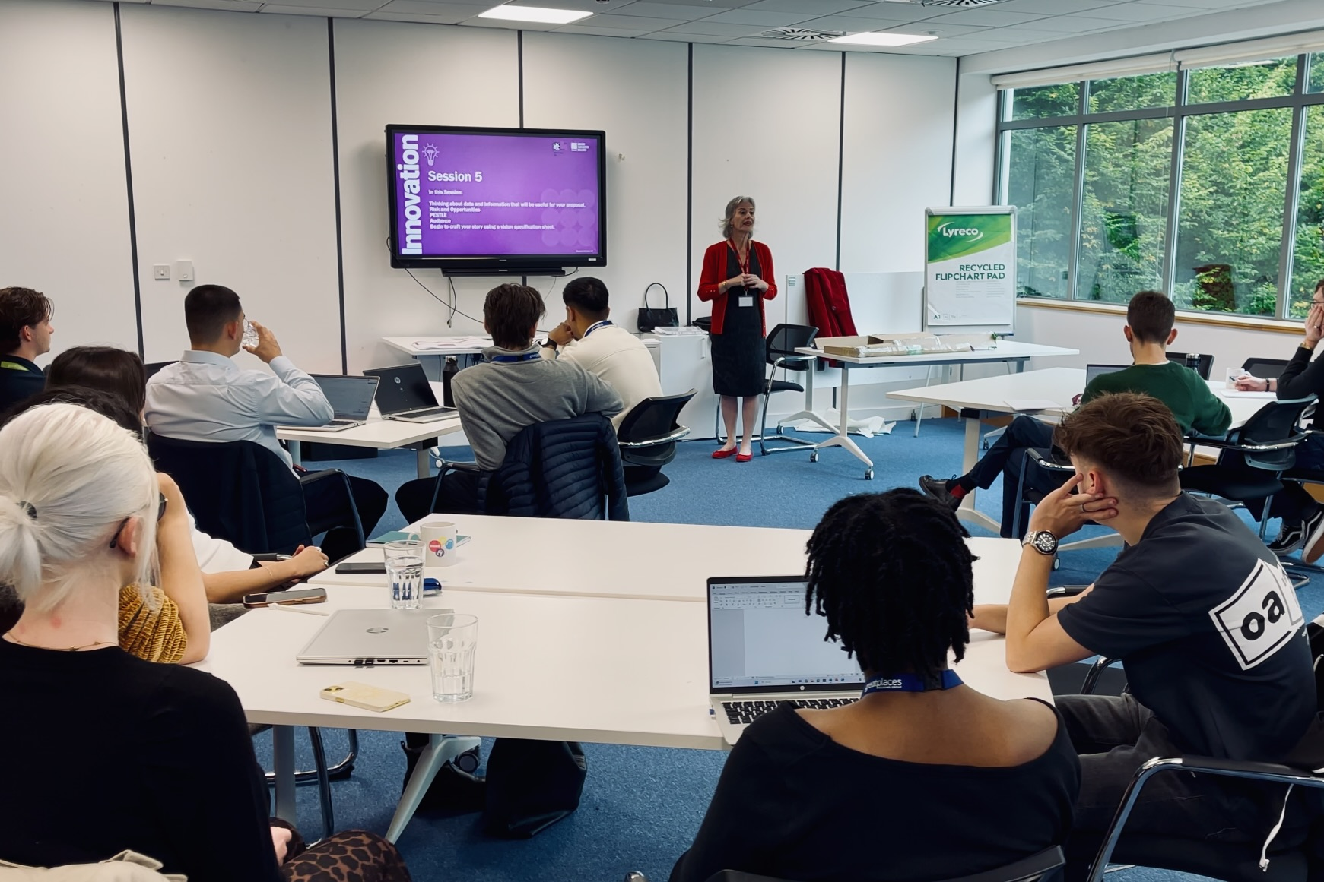
The Benefit To Apprentices
Gain an understanding of innovation
Generate and develop ideas
Introduction to Change
Increased soft skills
Improved confidence
CPD
Helps with apprenticeship
Counts towards Off The Job Tracker*
Enhanced CV
We have invested time to help Alex grow and the Innovation Ambassadors Programme was a big part of that. I would recommend this course to anyone who wishes to invest in their apprentices” – Digital Inclusion and Projects Lead, Wigan

Slide 9

How Is It Delivered?
Delivery is flexible
We Recommend:
2 or 4 sessions,
Delivered Daily, Weekly or Monthly.
With careful planning apprentices can mix and match their attendance which gives them and their employer greater flexibility.
E.g. you could set up 2 weeks of 2 day delivery and an apprentice could attend both sessions in one week or attend day one in week one and day two in week two.

Slide 10
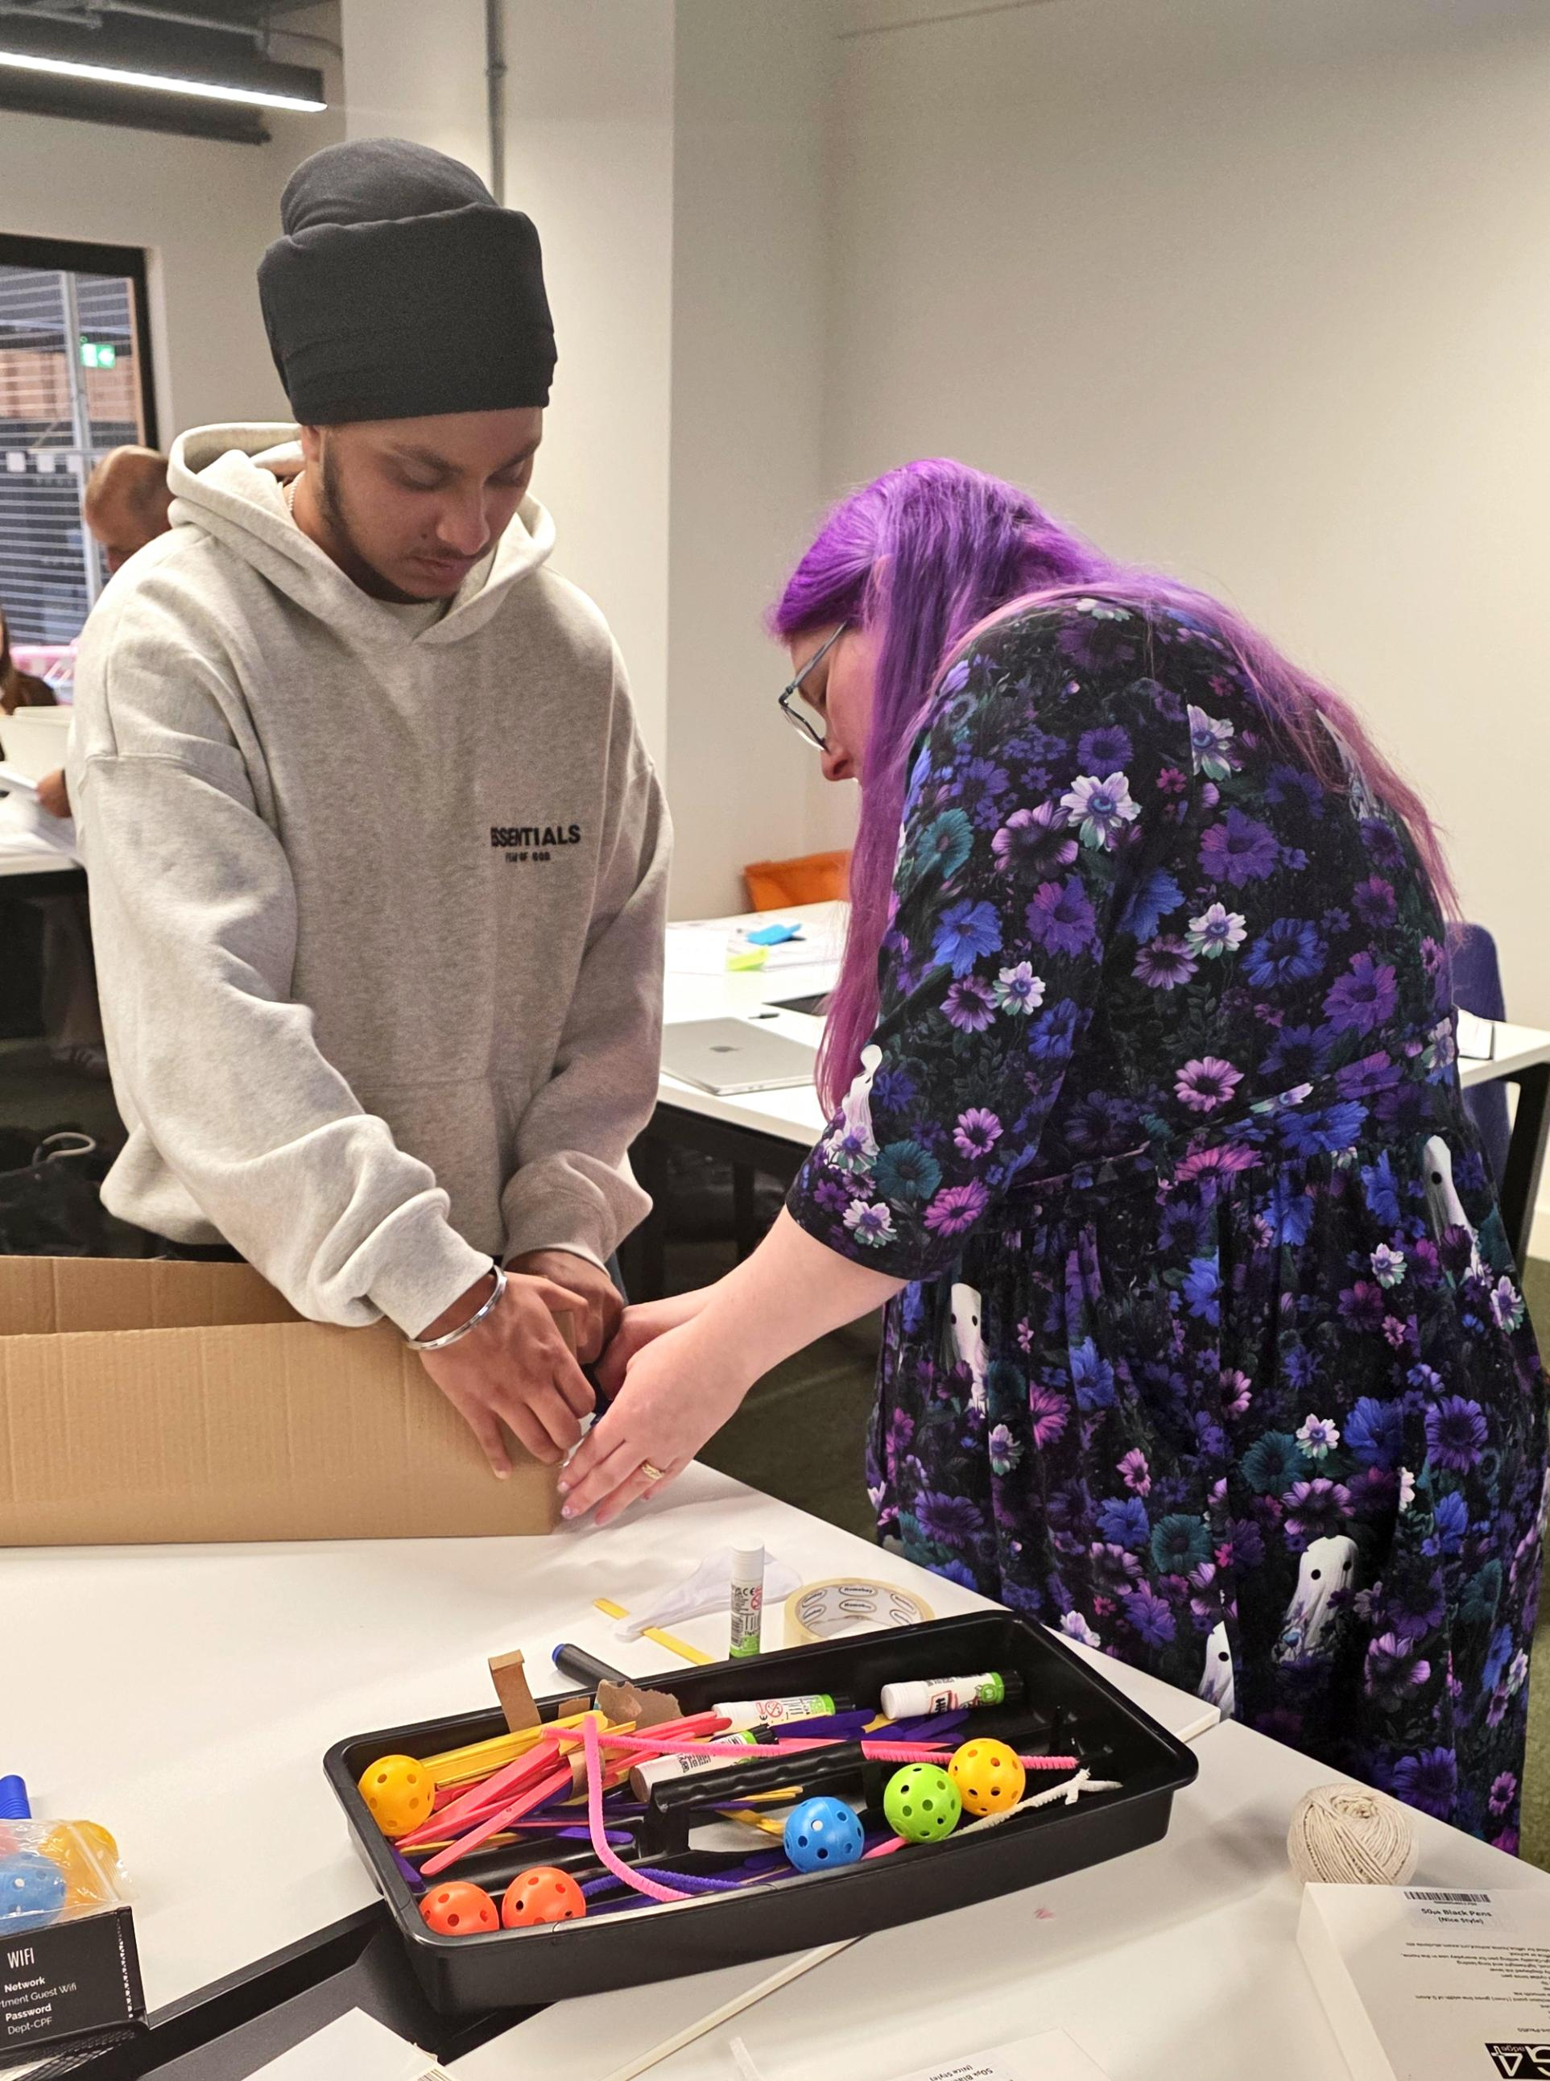
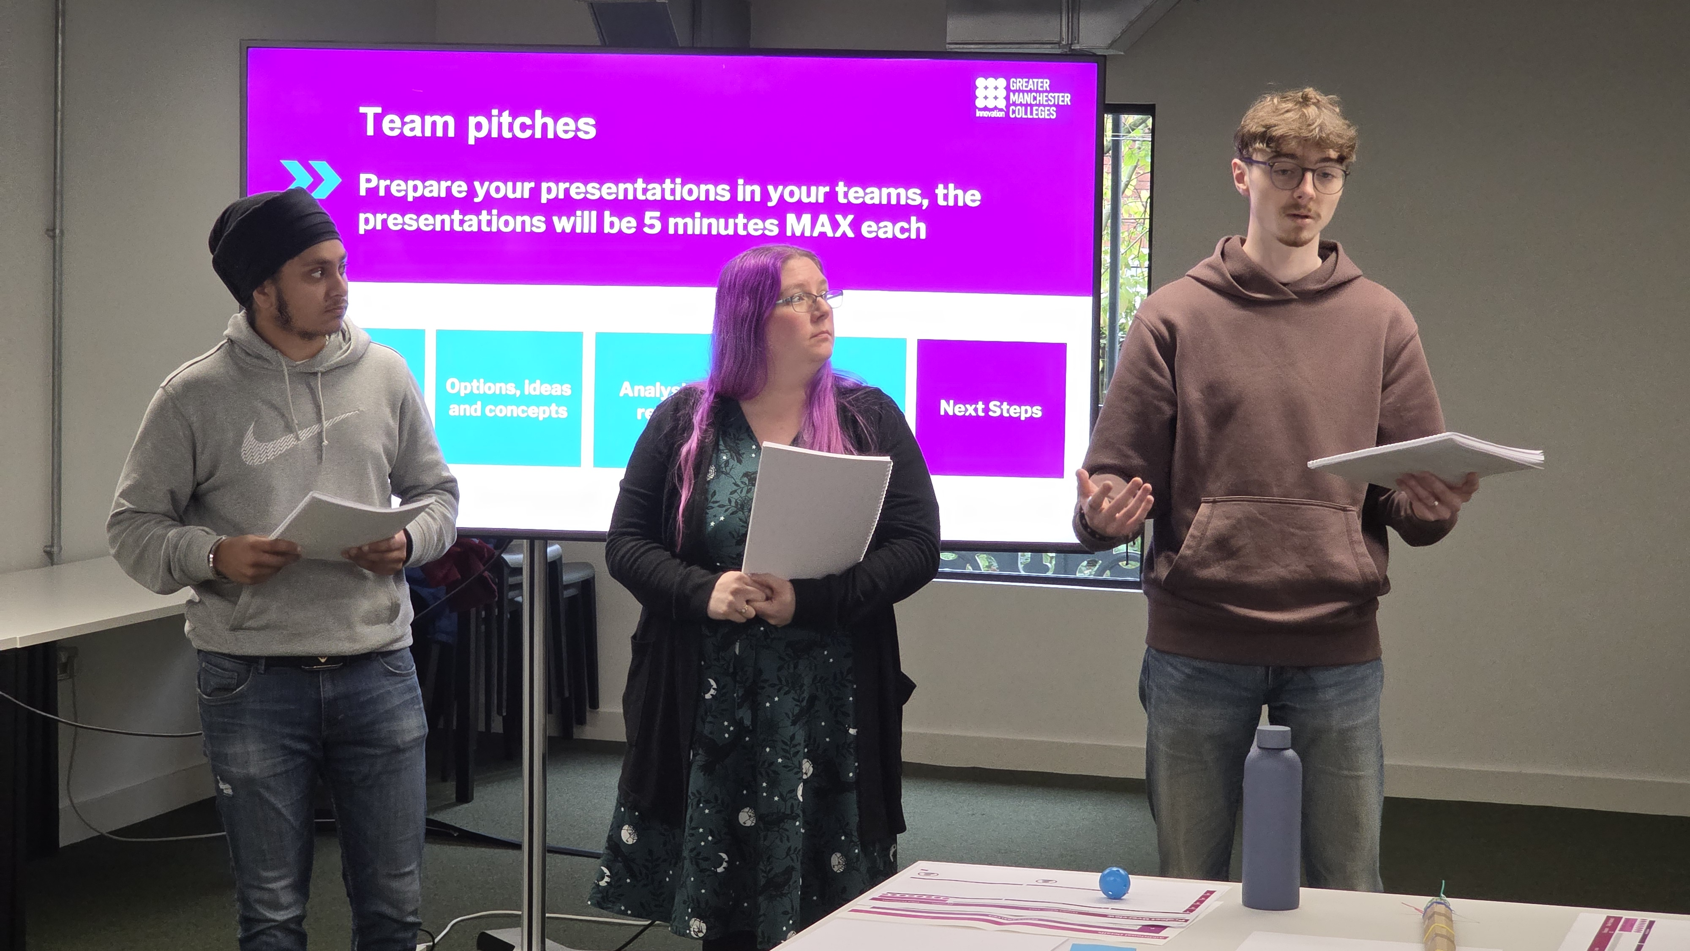
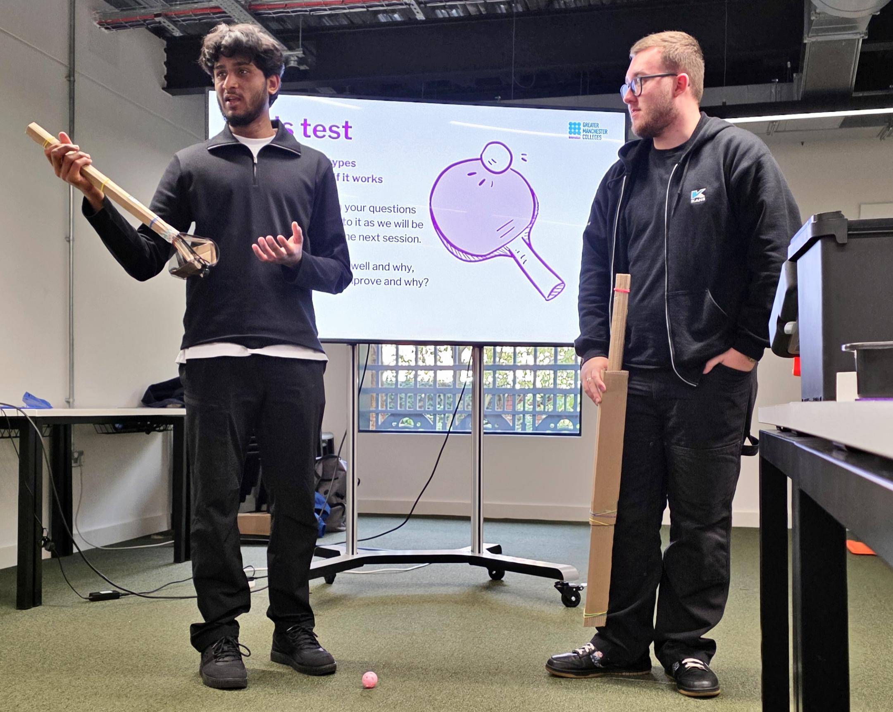

Slide 11
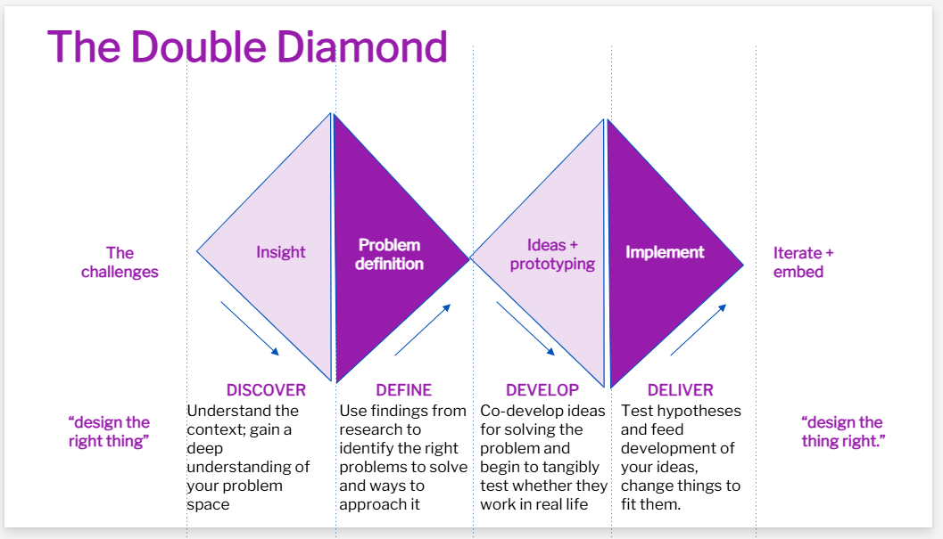


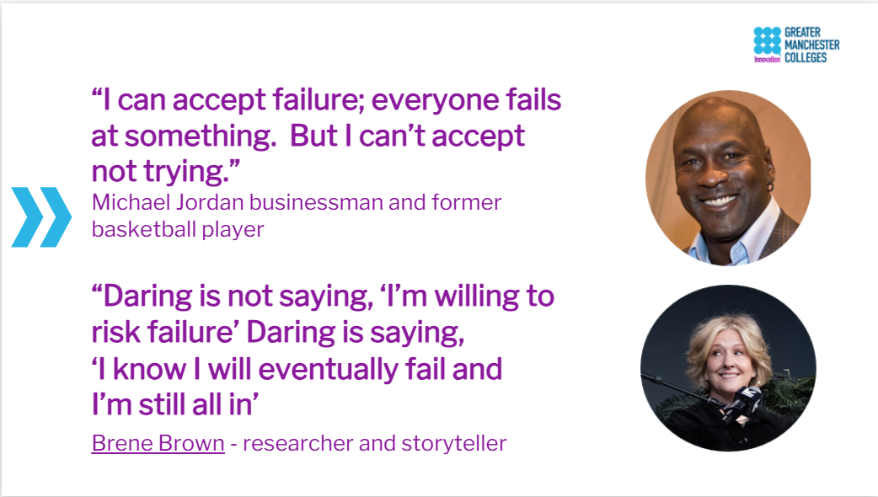
Delivery Slide Deck

Slide 12
Impact - Confidence
Before The Course |  | On Completion
How confident do you feel defining innovation?
4.8/10 |  | 8.9/10
How confident do you feel developing ideas?
5.5/10 |  | 8.5/10
How confident do you feel in presenting ideas to managers?
5.4/10 |  | 8.5/10
Measurement of Learner confidence at the start and end of the 2 day course shows a marked improvement.
“I was working with people from completely different backgrounds. It taught me to see problems from different angles and how to better communicate my ideas.” Joe

Slide 13

Impact – Apprentice Completers
“Fantastic session! Loved how it reframed my thinking & gave me new tools!” – Level 3 Digital Marketing Apprentice
“I feel like I can aid the development of others in my company by sharing this knowledge. I also feel like I can offer more to the company as an innovative engineer.” – L4 Engineering Apprentice
https://vimeo.com/1077930075

Slide 14
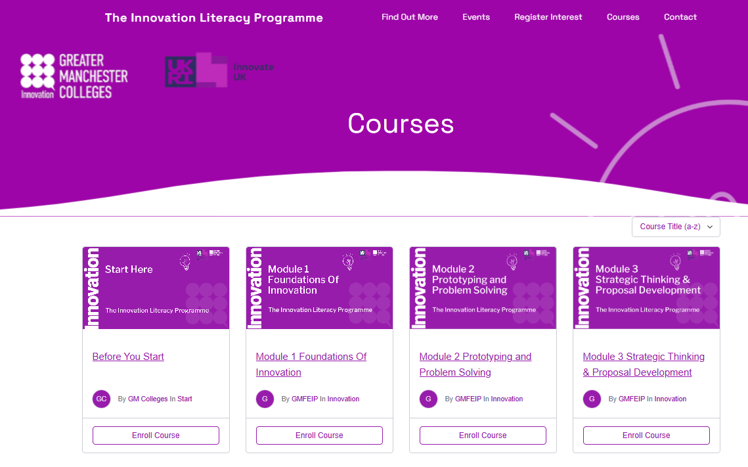

How is Learning Measured?
All apprentices are given access to our bespoke learning management system where they will:
Complete quizzes to complete modules,
Provide feedback on the programme
Rank their confidence before and after the programme
Locate additional resources such as the glossary
www.innovationliteracy.co.uk

Slide 15
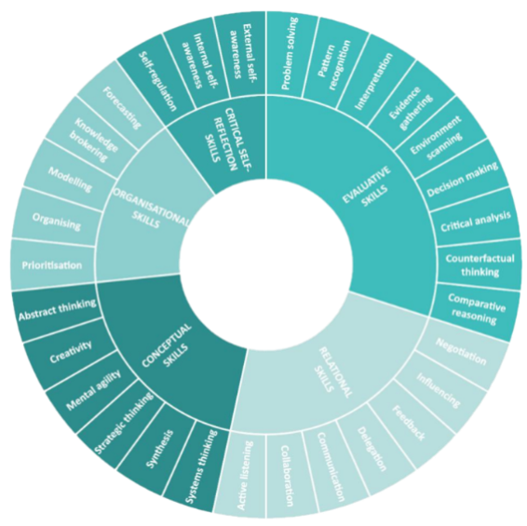
How is learning benchmarked?
The Innovation Commercialisation and Entrepreneurship Skills framework .
The framework details the skills and attributes that employees need to develop to innovate in the future.
This is the only programme that maps to all skills
Find out more:
​
ICE Framework
Notes:
IRC ICE Skills Framework
a framework of the skills underpinning innovation, commercialisation, and entrepreneurship. It builds on the Innovation Skills Framework developed in partnership with Innovate UK (IUK) and the Institute for Apprenticeship and Technical Education (IfATE) by extending the approach developed in that framework to include commercialisation, and entrepreneurship. This framework was developed to serve as a reference point for policy discussions about skills and as a practical tool to help a wide variety of organisations to shape hiring, training, workforce deployment and development, and curriculum design strategies (to name a few practical applications). It was developed using a mixed methods including a review of over 70 skills frameworks and models for innovation, commercialisation, and entrepreneurship, followed by a set of iterative multi-stakeholder consultations. Over 1000 activities, processes, tasks, skills, knowledge behaviours and traits were identified from the literature and were systematically reviewed, thematically grouped, and interpreted to derive relevant tasks and related skills. These were iteratively refined through reflective analysis in workshops to provide stakeholders the opportunity to feed back on the emerging framework and while also learning more about how organisations might apply it. Skills, in this framework, are the personal capacities that can add value (to a process, organisation, or endeavour) and can be acquired or enhanced through learning and development, and that contribute to the completion of innovation, commercialisation, and/or entrepreneurship related tasks. It focuses on base skills that underpin innovation, commercialisation, and entrepreneurship tasks in any organisational context. These skills sit alongside and require context-specific skills, as well as knowledge and enabling attitudes and resources that together, enhance innovation, commercialisation, and entrepreneurship. Notable frameworks that precede this work (e.g. EntreComp) cast a wider net and cover not only skills, but attitudes, behaviours, values, knowledge, tasks and traits that influence innovation, commercialisation, and entrepreneurship. The framework itself is relatively simple (see diagram below), highlighting 30 skills grouped into five categories. It is also modular, allowing the user to focus on innovation, commercialisation, or entrepreneurship individually, or engage with all the above. The framework also offers different starting points that enable users to tailor their engagement to their specific contexts. For example, users of the framework can select

Slide 16
ICE against KSB and Bloom's Taxonomy
ICE Skill Category | Related Apprenticeship KSBs | Bloom’s Level
Critical Self-Reflection Skills | Self-awareness, continuous improvement | Evaluate
Organisational Skills | Planning, prioritisation, resource management | Apply
Conceptual Skills | Creativity, strategic thinking, synthesis | Create
Evaluative Skills | Analytical thinking, decision-making | Analyze/Evaluate
Relational Skills | Teamwork, communication, collaboration | Apply

Slide 17
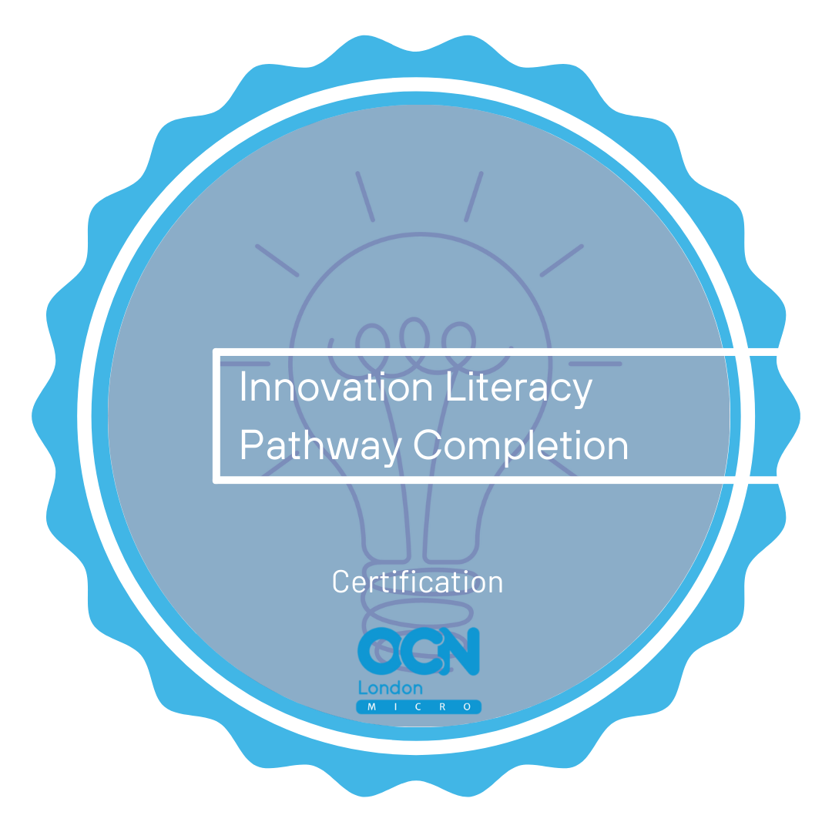
Course Accreditation – OCN London
Upon completion of modules 1-4, apprentices receive an accredited micro-credential/Digital Badge. Issued by OCN London
Each badge lives in a digital wallet that can be shared online and kept on a mobile device.

Slide 18

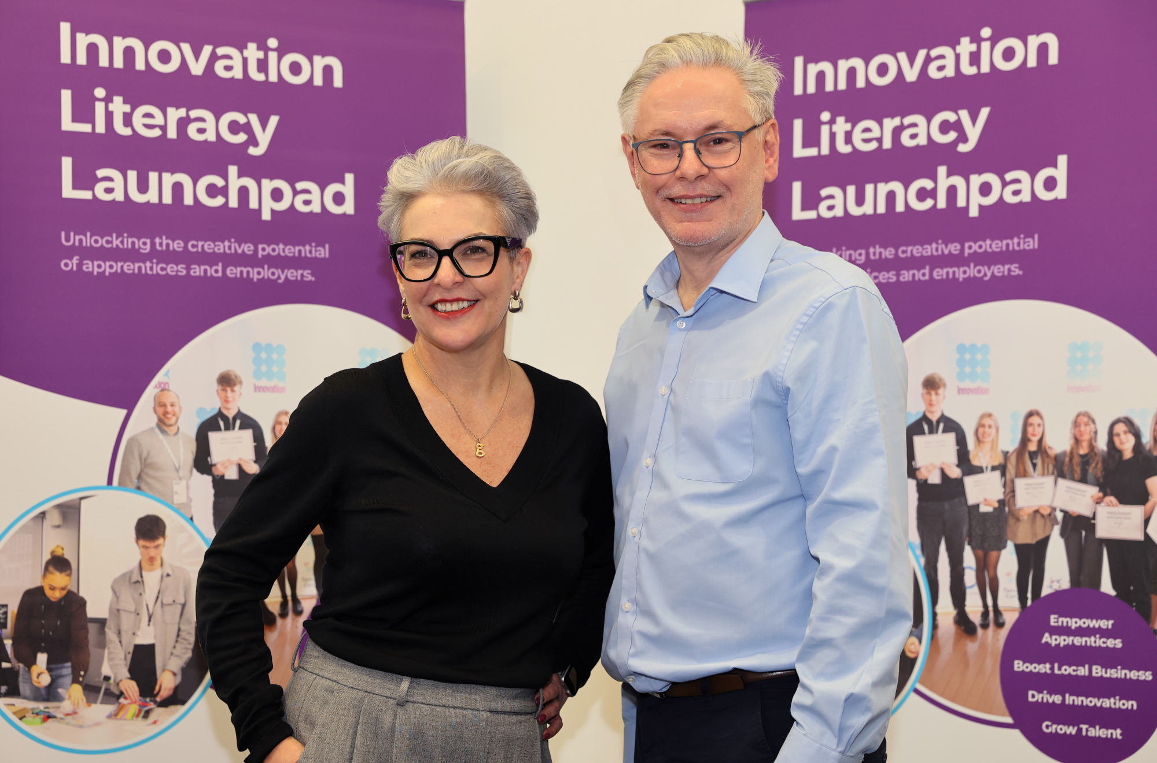
Questions?
Contact Dave Murat or Coral Grainger
innovationliteracy@oldham.ac.uk

Slide 19
Important Note:
Statement on Innovation Literacy Training and Off-the-Job Training Eligibility
The Innovation Literacy Training programme is funded by Innovate UK and operates entirely outside of the Department for Education (DfE) and ESFA-funded apprenticeship programmes. It does not draw down apprenticeship funding and therefore does not conflict with apprenticeship funding rules, including the “one funded programme at a time” policy.
Under the 2025–2026 apprenticeship funding rules, apprentices are required to complete a minimum of six hours per week of off-the-job (OTJ) training that is relevant to their apprenticeship standard and supports the development of new knowledge, skills, and behaviours.
While Innovation Literacy Training is not part of the formal apprenticeship curriculum, its content may align with the KSBs of certain standards. As such, it may be eligible to count towards an apprentice’s OTJ requirement.
However, it is the responsibility of the apprentice and their FE college assessor to determine whether the training is relevant and can be recorded as OTJ. This should be assessed on a case-by-case basis and clearly documented in the training plan.

